Slide 1
Impact of CP-violating phases of
Minimal Supersymmetric Standard Model
On Lepton Flavor Violation Processes
Based on [ arXiv:0810.4233]. Published in JHEP 0901022 by: Y. A , Yasaman Farzan.

Slide 2
Discrete symmetries:
Parity
Time reversal
Charge conjugate
Sakharov conditions
Baryon number (B) violation:
Violation of C and CP;
Departure from thermal equilibrium.

Slide 3
For this reason, studying EDMs of the elementary particles is of prime importance as it can teach us about CP-violation which is closely related to the creation of the baryon asymmetry of the universe.
Elementary particles can possess EDMs, only if the CP-symmetry is violated.
In fact in the Kaon and
B-meson sector, CP symmetry
has been observed to be
violated in accordance
with the prediction of
the Standard Model
SM of elementary particles
allows for CP-violation:
q-term in QCD
CKM matrix in quark sector
PMNS matrix in lepton sector

Slide 4
The maximum possible values of
EDMs in the context of
SM are extremely small
So far no electric dipole moment
for the electron or neutron has been
detected but strong bounds on
these quantities have been obtained.
<
The CP-violating sources of the SM are not large enough to explain
the baryon asymmetry of the universe
Upper bound on EDMs much larger than the SM prediction would indicate new
sources of CP-violation with origin in physics beyond the SM.

Slide 5
New sources in context of MSSM:
While the Standard Model contains just one CP phase, more phases can appear in extensions of SM. For example, Higgs doublet model, little Higgs Model or Extra dimension Models and Minimal Supersymmetric Standard Model.
The Minimal Supersymmetric Standard Model (MSSM) is the most popular model beyond the SM. The general MSSM introduces 44 sources of CP-violation. Mainly for the sake of simplicity, studies in the literature are concentrated on the mSUGRA model.
In the constrained MSSM the number of independent CP-violating phases are reduced to two which are usually attributed to the phases of a₀ and the μ-term.
There are 2 kinds of CP phases:
Phases of flavor conserving terms in superpotential and soft supersymmetric Lagrangian.
Phases flavor violating terms in superpotential and soft supersymmetric Lagrangian.

Slide 6
Effect of CP-violating phases on rare processes
In the framework of the Standard Model, Lepton Flavor Violating (LFV) processes such as m→ e g , m N→ e N and m→ e ee are forbidden.
Various models beyond the SM can give rise to LFV rare decay with branching ratios exceeding the present bounds
For low scale MSSM, these experimental bounds imply stringent bounds on the LFV sources in the Lagrangian
The MEG experiment at PSI, which is expected to release data in summer 2009, will eventually be able to probe Br(m→ e g ) down to 10^-13. In our opinion, it is likely that the first evidence for physics beyond the SM comes from the MEG experiment.

Slide 7
Muons in the MEG experiment a reproduced by decay of the stopped pions (at rest) so they are almost 100% polarized.
This opens up the possibility of learning about the chiral nature of the underlying theory by studying the angular distribution of the final particles.
It has been shown that by measuring the polarization of the final state in the decay modes μ→ e γ and μ→ eee one can derive information on the CP-violating sources of the underlying theory.
Notice that even for the state-of-the-art LHC experiment, it will be quite challenging (if possible at all) to determine the CP-violating phases in the lepton sector.
Suppose the LHC establishes a particular theory beyond the SM such as supersymmetry. In order to learn more about the CP-violating phases, the well-accepted strategy is to build yet a more advanced accelerator such as ILC. Considering the expenses and challenges before constructing such an accelerator, it is worth to give any alternative method.

Slide 8
LFV sources in the Lagrangian can also give rise to sizeable μ-e conversion rate. There are strong bounds on the rates of such processes
The PRISM/PRIME experiment is going to perform a new search for the μ-e conversion .. It is shown that if the initial muon is polarized (at least partially), studying the transverse polarization of the electron yields information on the CP-violating phase. We elaborate more on this possibility taking into account all the relevant effects in the context of R-parity conserving MSSM.
The low energy effective Lagrangian that gives rise to μ→ e γ can be written as
A_{L} and A_{R} receive contributions from the LFV parameters of MSSM at one loop level.

Slide 9
the longitudinal and transverse directions as follows:
The partial decay rate of an anti-muon at rest into a positron and a photon equal to:
It is convenient to define:
By measuring the total decay rate and the angular distribution of the final particles, one can derive absolute values A_{L} and A_{R} .
We define double correlation of polarization in direction T₁ and T₂ as

Slide 10
m- e conversion
The effective LFV vertex in the penguin diagrams can be parameterized as follows
where p_\mu-p_ is the four-momentum transferred by the photon or Z-boson and Q_{q} is the electric charge of the quark. is the coupling of left(right)-handed quark to the Z-boson. H_{L} and H_{R} are the effective couplings of the Z boson to lepton. A_{L} and A_{R} are the same couplings that appear in previous equation.

Slide 11
The partial decay rate is equal to:
Where S is a numerical factor that includes the nuclear form factor and
in which Z and N are respectively the numbers of protons and neutrons inside the nucleus.
Let us define

Slide 12
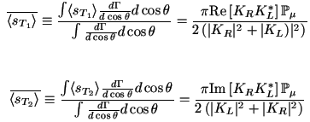
We define transverse polarization of emitted electron in direction T₁ and T₂ as
The advantage of the study of the μ-e conversion over the study of μ ◊e g is that in the former case there is no need for performing the challenging photon polarization measurement. The drawback is the polarization of the initial muon. While the polarization of muon in the μ ◊e g experiments is close to 100%, the muons orbiting the nuclei (the muons in the μ-e conversion experiments) suffer from low polarization of 16% or lower. In this paper, we take
For any given value of , our results can be simply re-scaled.

Slide 13
Effects of the CP-violating phases of MSSM
We consider the minimal Supersymmetric Standard Model with superpotential:
The soft supersymmetry breaking at the electroweak scale
After electroweak symmetry breaking gives rise to LFV masses:

Slide 14
The strong bound on the electric dipole moment of the electron implies strong bounds on the phases of A_{e} , m and M₁. For this reason, we set the phases of these parameters equal to zero and focus on the effects of the phases of A_{m} and the LFV elements of mass matrices.
The CP-violating phases that can study in the polarizations are the phases of A_{i} the m-term, M₁ (the Bino mass) and phases of LFV elements of mass matrices in soft supersymmetry breaking Lagrangian
We focus on the effects of the em elements. Effects of et and mt elements will be explored elsewhere.
We have chosen the mass spectra corresponding to the P3 benchmark which has been proposed in [arXiv:0709.0098]. We have however let A_{e} and A_{m} deviate from the corresponding values at the benchmark P3.
Figure.1-2 shows versus phase A_{m} and phases of LFV elements.

Slide 15
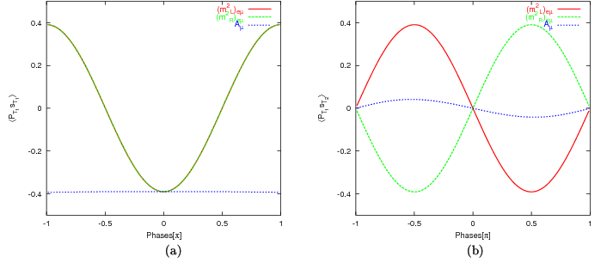
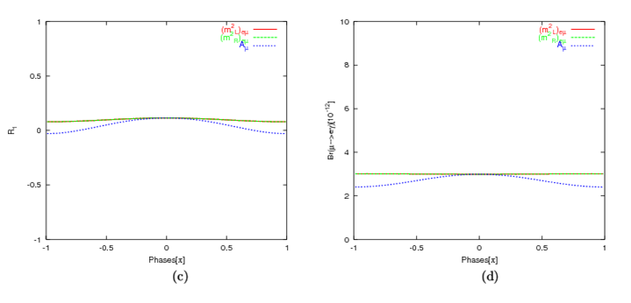
[S. Yaser Ayazi and Y. Farzan, JHEP 0901 022[ arXiv:0810.4233].

Slide 16
The input of Fig.2 is similar to that of Fig.1 except that a hierarchy is assumed between the left and right LFV elements: .As expected in this case, R₁ ~ 1 and the transverse polarizations are small. To draw Fig.3, we have set the LFV elements of equal to zero and instead we have set .
Figure.3-4 shows versus phase A_{m} and phases of LFV elements.
The following remarks are in order:
In all of these sets of diagrams, maximal corresponds to and vice versa.
When all the phases are set equal to zero, vanish but can be nonzero.

Slide 17
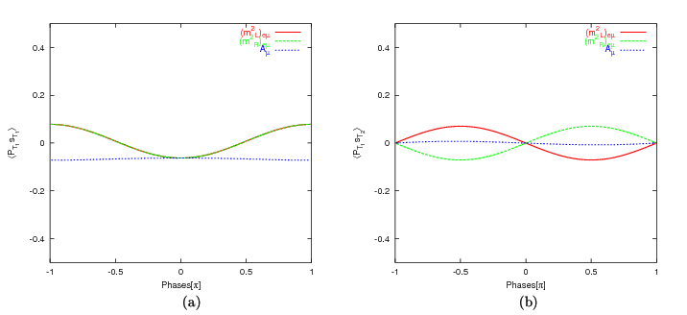
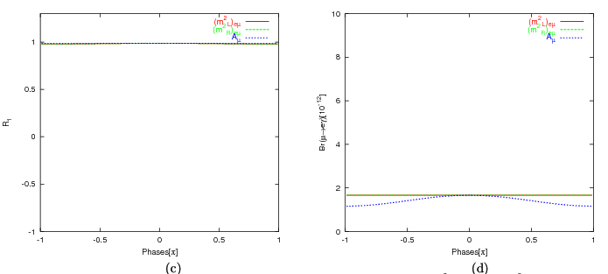
[S. Yaser Ayazi and Y. Farzan, JHEP 0901 022[ arXiv:0810.4233].

Slide 18
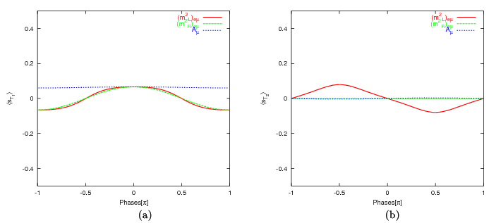
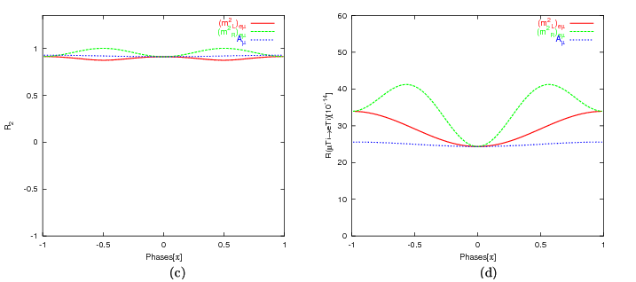
[S. Yaser Ayazi and Y. Farzan, JHEP 0901 022[ arXiv:0810.4233].

Slide 19
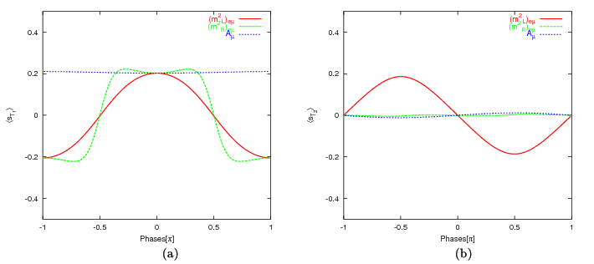
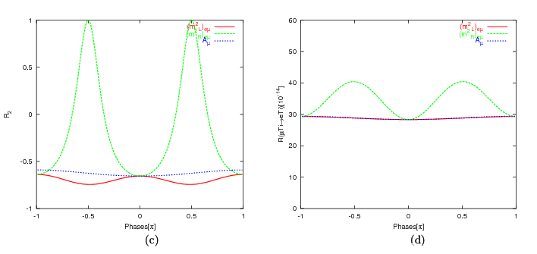
[S. Yaser Ayazi and Y. Farzan, JHEP 0901 022[ arXiv:0810.4233].

Slide 20
Resolving degeneracy
All the observables in the μ→ e γ experiment are determined by a pair of effective couplings A_{L}, A_{R} which receive contributions from various parameters in the underlying theory.
By measuring , one can reconstruct both A_{L} and A_{R} (up to a common phase). However, because of the degeneracies, it is not possible to unambiguously derive the values of the LFV elements and the CP-violating phases of the underlying theory from A_{L} and A_{R}.
Also, the observable quantities in the μ-e experiment are given by a pair of parameters (K_{L}, K_{R}) which depend on the LFV masses and CP-violating phases of the underlying theory. By measuring , it is possible to reconstruct | K_{L} |, | K_{R} | and their relative phase; however, deriving the LFV and CP-violating parameters of the underlying theory from (K_{L}, K_{R}) would suffer from degeneracies.

Slide 21
Fortunately, the pairs of K_{L} , K_{R} and A_{L} , A_{R} depend on different combinations of the LFV elements. Thus, there is a hope to solve a part of degeneracies by combining information from the μ→ e γ and μ-e experiments.
Fig.5 demonstrates such a possibility. In the case of the points depicted by red plus (+), green filled circle, dark blue circle and purple triangle, all the phases are set to zero except one of the phases which is specified in the legend and varies between 0 and 2p. In the case of points depicted by cyan squares, the phase of is set equal to 0.7 of the phase of which varies between zero and 2p /0.7.
We have chosen the values at the P3 benchmark for the lepton flavor conserving parameters. We have then searched for the values of the LFV em elements at which the observable quantities Br(μ→ e γ ), R( μ Τι-e Ti), R₁ and R₂ are in a given range. We have fixed A_{e} and Am to 700~GeV.

Slide 22
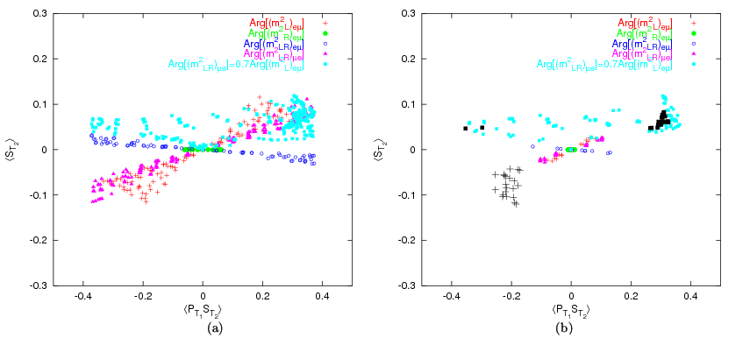
[S. Yaser Ayazi and Y. Farzan, JHEP 0901 022[ arXiv:0810.4233].

Slide 23
Suppose μ→ e γ and μ-e convention are detected and their rates are measured with some reasonable accuracy. Moreover suppose R₁ and R₂ are measured and found to be in the range indicated in the caption of Fig.5. The question is what configurations of LFV elements and the CP-violating phases can give rise to these values of the observables. To answer this question, we have looked for the solutions by varying
respectively in the range or given values of the CP-violating phases. We have then inserted the values of the LFV elements at the solutions in the formulas of and depicted it in Fig. 5-a by a point.
From Fig.5-a, we observe that all sets of the solutions depicted with various symbols reach to each other at the point
In summary, combining the information from μ→ e γ and μΝ - eN searches considerably lifts the degeneracies however, does not completely resolve them. By employing other observables, it may be possible to completely solve the degeneracies.

Slide 24
To examine how much forthcoming results on d_{e} can help us to resolve the degeneracies, we have presented Fig.5-b. This figure is similar to Fig.5-a with the difference that at each point in addition to observables in the μ→ e γ and μ-e conversion experiments, we have also calculated d_{e} . We have removed the points for which d_{e} >10^-29 ecm from the set of points depicted by colored symbols.
we have also depicted points satisfying the condition with slightly larger black symbols.
Notice that unlike in Fig. (a), in Fig.(b) the regions over which the squares and pluses are scattered have no overlap. This means d_{e} can help us to resolve the degeneracies.
Conclusions
We derive formulas for the transverse polarization of the final particles in terms of the couplings of the effective potential leading to m→ e g and m N→ e N processes.
We then study the dependence of the polarizations of e and photon in the m→ e g and m N→ e N on the parameters of the MSSM.
We show that combining the information on various observables in the m→ e g and m N→ e N search experiments with the information on d_{e} can help us to solve the degeneracy in parameter space and to determine the values of certain phases.

